Slide 1


HiveOT - The Hive Of Things
Introduction and Demo
Why HiveOT
Security of Things
Using the WoT TD
Hub Digitwin
Event Flow
Action Flow
Services
TD Challenges
Affordances
Forms
Other

Slide 2

Greetings
About me:
Author of HiveOT
Educated as Electronics Engineer
Switched to software development in ‘89
Love Coffee, IoT, FOSS, Linux and Golang!
Slowly gaining experience with WoT since 2023

Slide 3
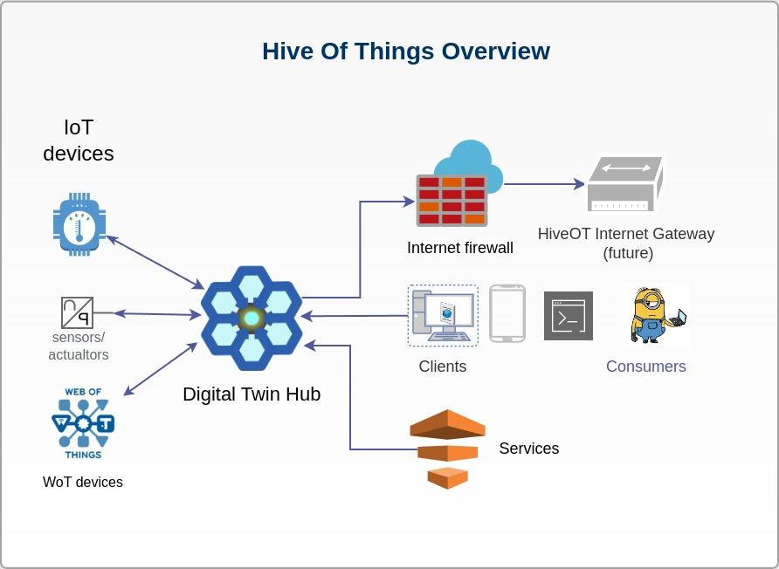
HiveOT - Introduction & Demo
What is it?
A Digital Twin IoT Hub
Objectives
Share information between IoT Devices, Services and Consumers
Secure
Extensible. Integrate with existing IoT Systems and services.
Based on WoT-1.1 Thing Specification
Digital Twin
But first, a little demo

Slide 4
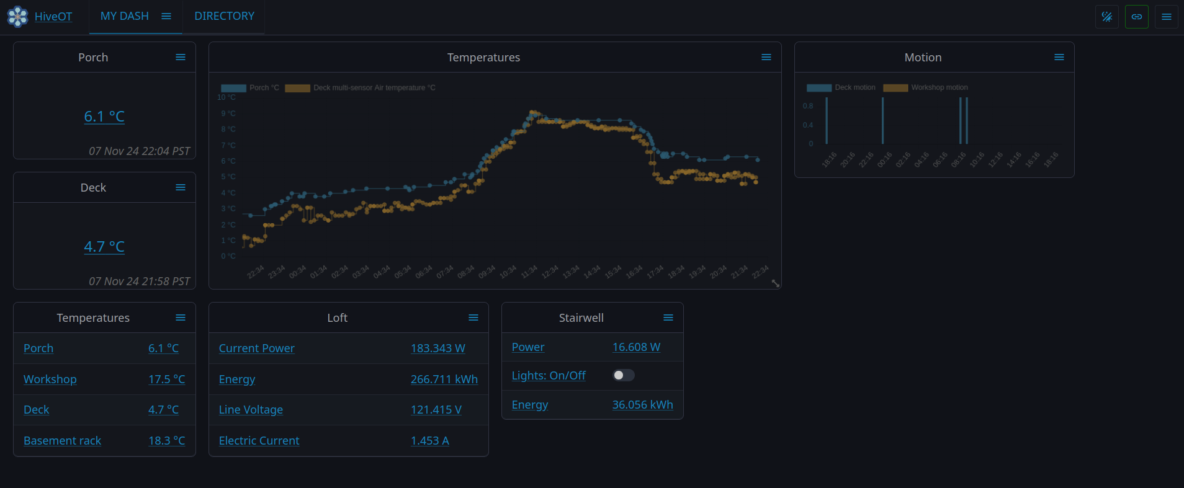
Demo time
(but, .. where is the pumphouse?)

Slide 5
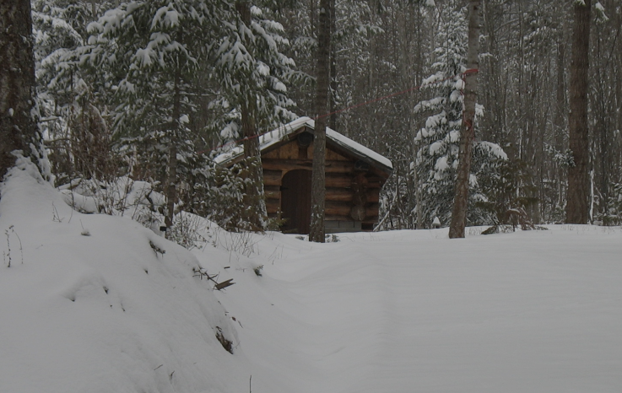

Why HiveOT?
A long time ago, like in 2010, there was a pump house. But, there were questions…
Does the heater still work?
Will it freeze in there?
How much energy is it using?
Any ‘unauthorized’ minions visitors?
So many questions!

Slide 6
Why HiveOT - Evolution
myzone
MyZone provides a 'it just works' approach to IoT data collection and automation using IoT sensors, devices and services.
NGSI-LD based
API based variant based on NGSI.
HiveOT
Redesign based on WoT TD-1.1 web of things. Multi-protocol.
2017
2020
2022/2023
lost in time…
2019
2021
2024 and beyond
Iot train
Connecting IoT devices and services using MQTT.
iotdomain
Simple standard for M2M discovery and exchange of information from IoT devices and related services.
gRPC / Cap’nProto
RPC based variants to explore RPC instead of message bus approach.
(Because its fun)

Slide 7
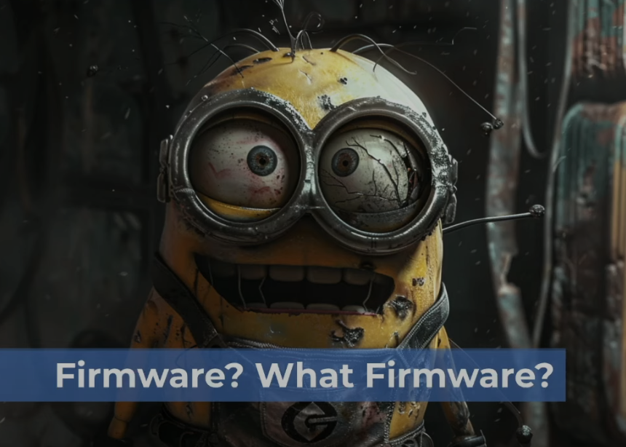
Security Of Things - concerns
IoT devices have a particularly large attack surface due to their internet-supported connectivity. ⁽¹⁾
Concerns:
Missing firmware updates
Weak authentication
Shared network access
Lack of encryption
… on and on and on …
Some examples:
The 2016 Mirai botnet was made possible by unsecured IoT devices.
Target’s credit card breach (2013) stole login credentials from an HVAC vendor IoT sensors.
… on and on and on …
(Credits: https://www.youtube.com/watch?v=Cxrwpij2MSQ)
https://www.techtarget.com/iotagenda/definition/IoT-security-Internet-of-Things-security#:~:text=Lack%20of%20encryption.,devices%20are%20secured%20and%20encrypted.

Slide 8

Security of Things - HiveOT
Rule #1: HiveOT devices do not run (network) servers.
IoT devices connect to a HiveOT Hub through a provisioning process.
Greatly reduced attack surface. No direct access to the device.
Encrypted network connections.
HiveOT Hub provides centralized:
Authentication & authorization
Consumer facing connectivity
Security protocols
Firmware updates

Slide 9
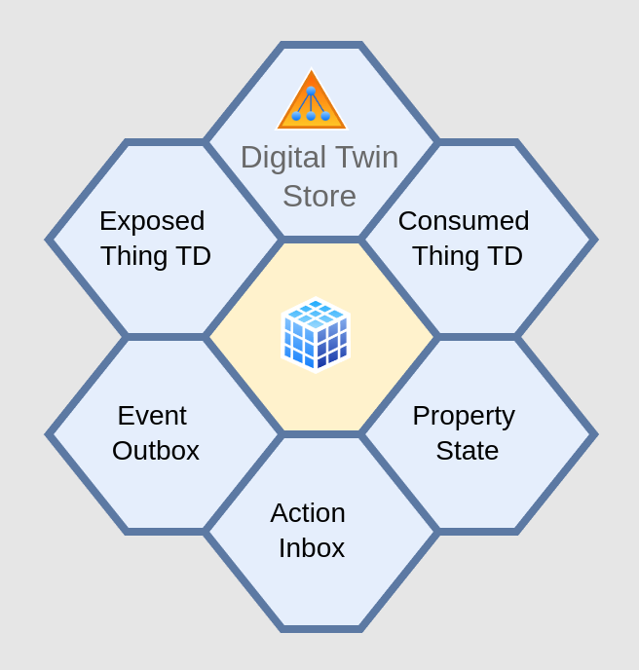

Use of the Thing Description Document (TDD)
Device TDD
Sent by device agents
Digital Twin TDD
Served to consumers
Forms replaced with with Hub endpoints
A new Thing ID: dtw:{agentID}:{thingID}
Only one set of top level operations needed to use all things.

Slide 10
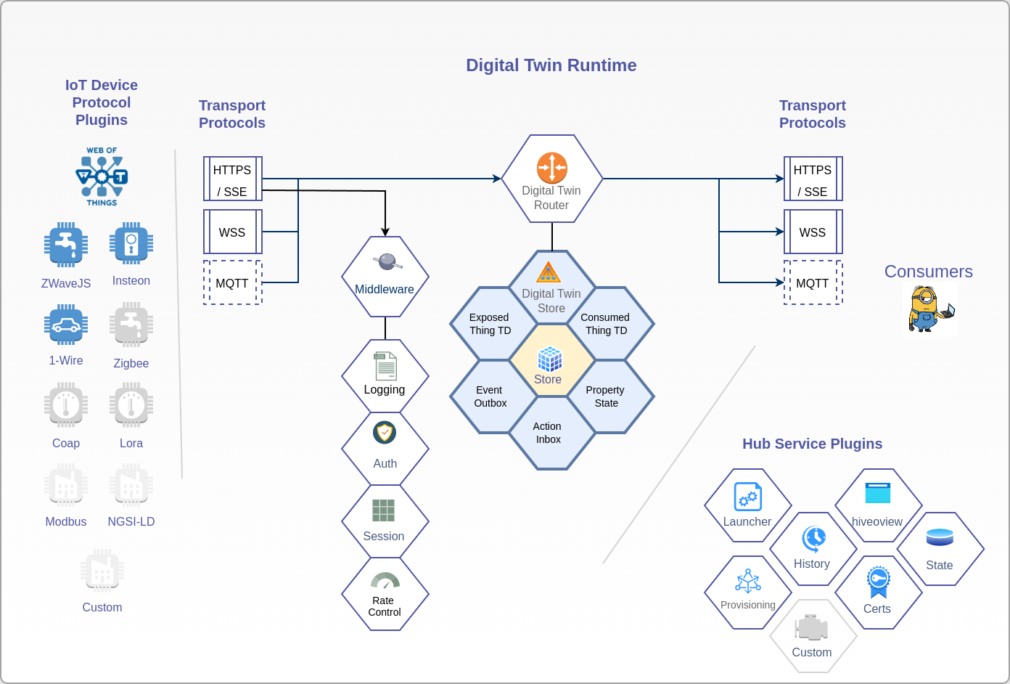
HiveOT Hub
Digital Twin Runtime
Transport Protocols
Middleware
Router
Digital Thing Store
IoT Device Protocols
WoT
ZWave
1-wire
…etc
Services
Launcher
Provisioning
History
State storage
HiveOView (web view)
…

Slide 11
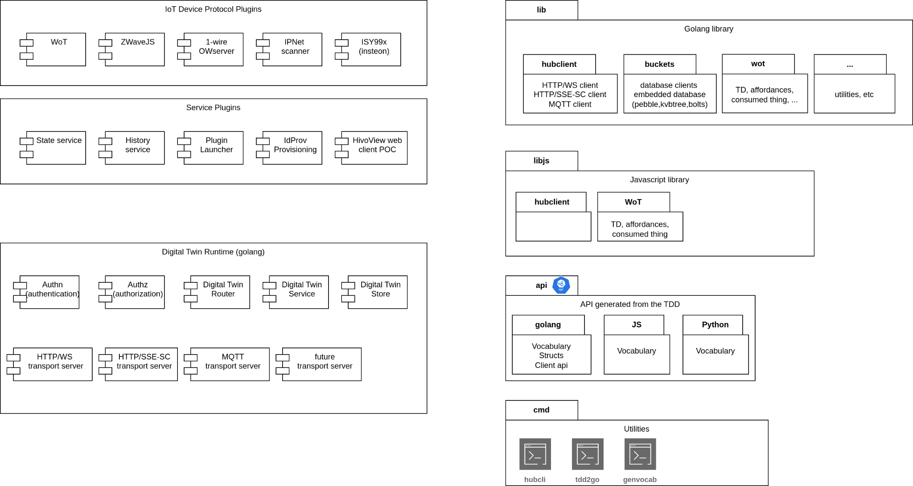

Hub Components

Slide 12

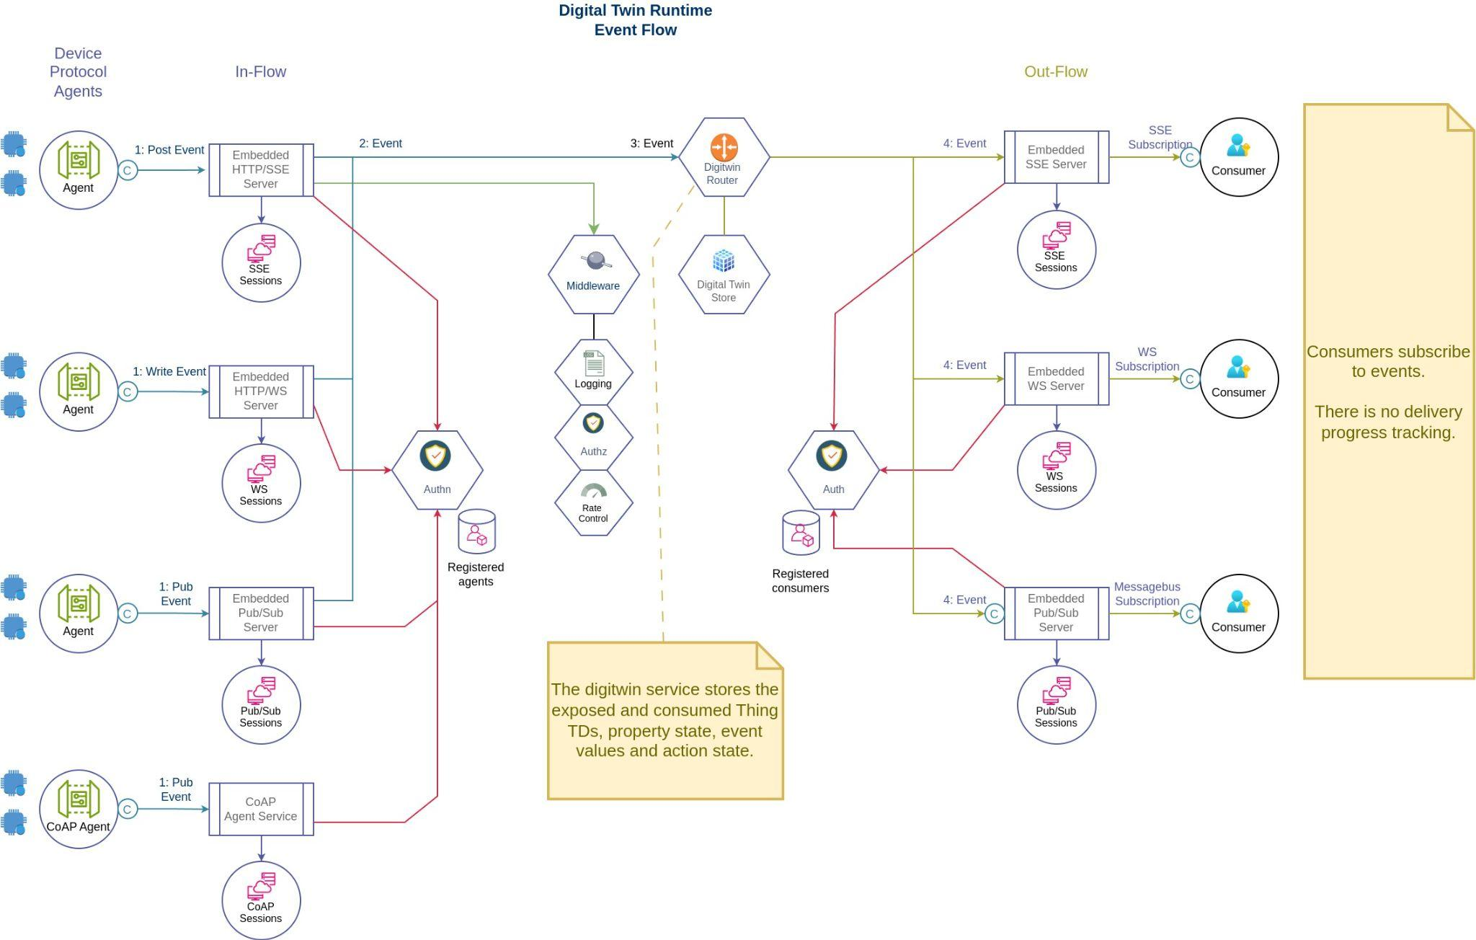
HiveOT Hub - Event Flow

Slide 13
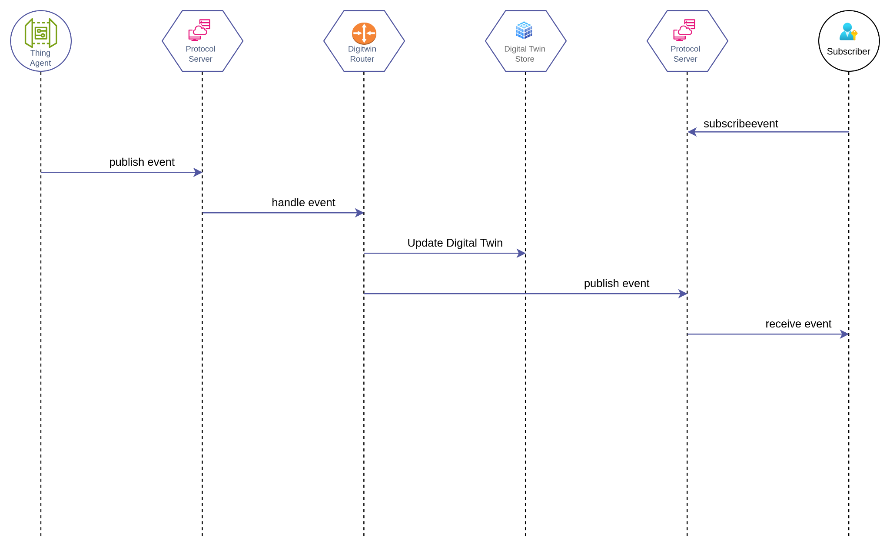
Event Sequence

Slide 14
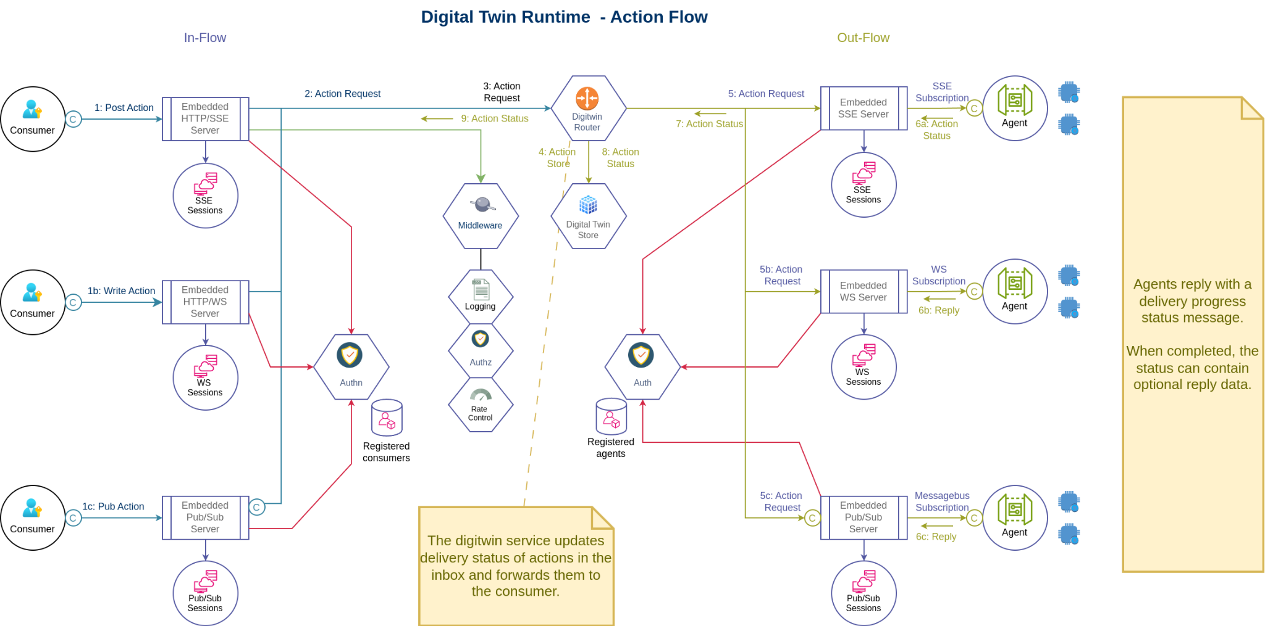

HiveOT Hub - Action Flow

Slide 15
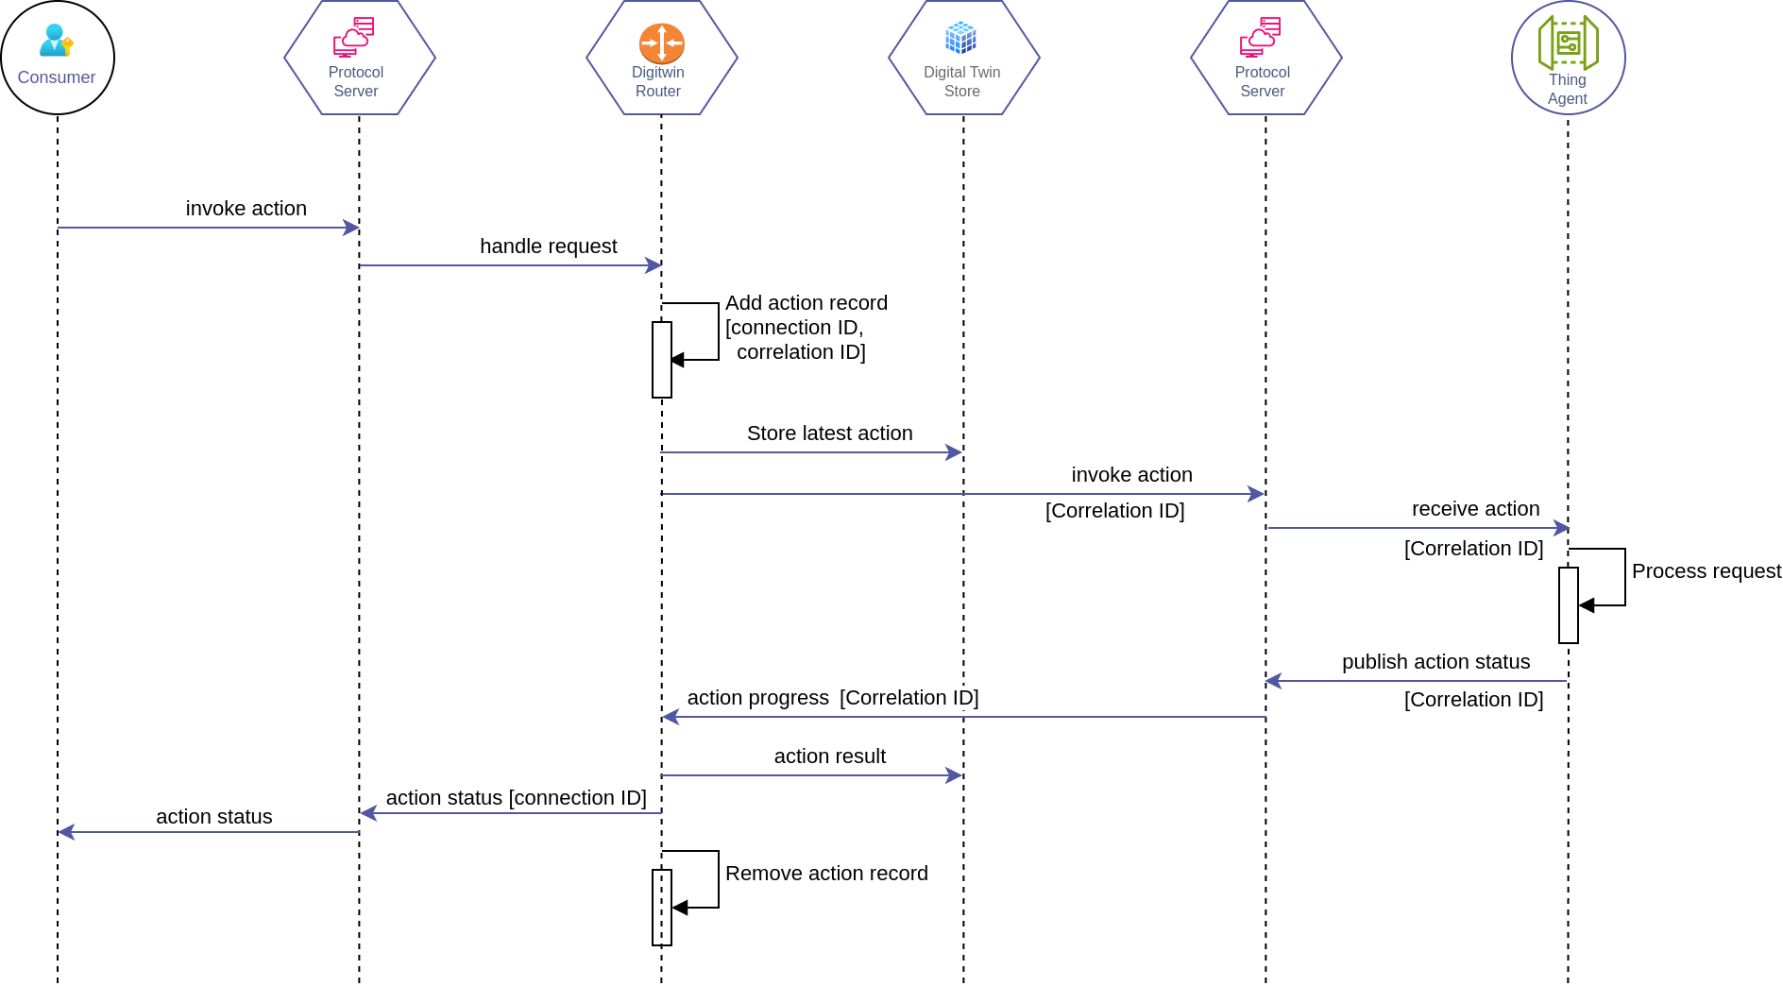
Action sequence

Slide 16
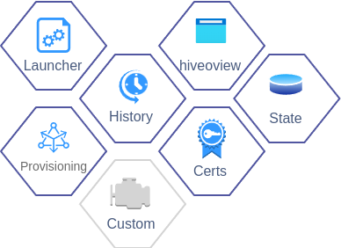
Hub Services - Batteries Included
Launcher - starting and stopping services
State - small storage for agents, services and consumers
History - event history
Hiveoview - example web ui
Certificates - server certificate management
Provisioning - provisioning of devices
Custom - easily extensible

Slide 17

IoT Protocol Bindings - Integrations
WoT binding using TDs
ZWave
Insteon
1-wire
… many more to come …
Coap devices
LoRa devices
Internet services
IFTTT

Slide 18
Hub Commandline Utilities
hubcli - console admin tool to manage users and device, view events and inspect TDs.
tdd2api - proof of concept to generate a (golang) API from a TD
genvocab - generate vocabulary in golang, javascript and python

Slide 19

TD Challenges - Affordances (1)
When to use properties vs actions?
Should a light switch be a property or an action?
Can it be both?
Academic rules
If it affects internal state then it is a property, otherwise an action.
Human (fuzzy) rules
If it triggers an actuator then it is an action
Mimics behavior in the real world. If there is a button or switch for it then it is an action.
But … volume control, mute buttons, mixer sliders, media start/stop …

Slide 20

TD Challenges - Affordances (2)
When to use properties vs events?
Should a light switch status be a property or an event?
Should a temperature be a property or an event?
Should a temperature alarm be a property or an event?
Academic rules
If there is no internal state then it is an event, otherwise a property
If it is immutable then it is a property (duh!)
Can be counter intuitive
Human (fuzzy) rules
If it is time sensitive (eg sensors, alarm) then it is an event
If you want to see the history of it then it is an event. (an example of it being time sensitive)
If it is a primary function of the device then it is an event (sensor outputs, alarms,...)
If it is an event and has internal state then it is also a property (with the same name) .. twin affordance
If it is configuration then it is a property … but, when is something a configuration? …
Recommendation to the WoT working group
Define rules with a set of examples for people to go by so they won’t have to guess. It will help interoperability and usability.

Slide 21

TD Challenges - Affordances (3)
Is there a correlation between properties, actions and events?
What does it mean if they can have the same name?
Workaround
In HiveOT assume an implicit relationship. An action named ‘switch’ can result in an event named ‘switch’ and updates a state property named ‘switch’.
It would be confusing to repurpose the same name with a different meanings between actions, events and properties, so this is not done in HiveOT..
Defined as ‘twin affordances’.

Slide 22

TD Challenges - Affordances (4)
How to get the result of an action?
If action A is invoked how to know what the result is?
What if the action has transient states?
What if the action has no states (RPC calls)
Option 1 - action status message
Define an action status message (operation) with a progress field.
Things publish a status message when actions are in progress or completed.
Include a request ID in the transport bindings to correlate request and response
Might need some ‘creative’ thinking for SSE
Option 2 - use properties
A property reflects the state with the result of an action.
Problems:
How to correlate the property with the action?
Doesn’t work for stateless (RPC) actions
Multiple states can be affected by a single action
Only idempotent actions can be tracked, how to track 3x increment volume
No minions were hurt in this action

Slide 23
TD Challenges - Affordances (5)
How to identify the actual ‘meaning’ of a property, event or action?
Without a standard vocabulary it is up to the human to determine what something means. This stands in the way of automating integration.
Workaround
For now, define a ‘ht:’ namespace vocabulary in @context and use these in @type fields.

Slide 24
TD Challenges - Affordances (6)
Support for enum titles?
Enums are just a list of keys in the TD. When using these in the TD, how to provide a proper presentation for them? Eg, a title?
Workaround
Don’t use enums for human consumption. Use OnOff if possible, which supports a const as value and Title for consumption. Enjoy.

Slide 25
TD Challenges - Affordances (7)
How to add multi-line descriptions?
Documenting properties, inputs or outputs can sometimes take more than a single line. However the TDD only accepts a single string and JSON doesn't do multi-line strings.
Workaround
Accept an ‘array’ of strings here. The awesome TD playground validator will complain. It is tough to be a validator.

Slide 26
TD Challenges - Affordances (8)
How to support multi-line comment fields
Same problem as with multi-line ‘description’ fields.
Workaround
Accept an array of strings here. Same as previous point.

Slide 27
TD Challenges - Affordances (9)
How to describe a map of objects in the action output data schema?
Workaround
Don't use maps, use arrays.

Slide 28
TD Challenges - Affordances (10)
How to read the latest event value?
A UI that displays events might want to show the last known event. However, the TD has no operations for ‘readevent’ and ‘readallevents’.
Workaround
HiveOT adds these operations in the “ht:” namespace.
The digital twin store also stores the latest event values.
The history services persists historical events

Slide 29

TD Challenges - Affordances (11)
How to describe basic vs advanced properties, events and actions in the TD?
Use case: human consumers might be interested in some properties, events or actions but not all of them. The human consumer should be able to just look at the essential data without being overwhelmed with more advanced ones.
Some zwave devices have close to 100 properties of which only a handful are useful to the regular consumer. How to differentiate them?
Options
1: use the ht vocabulary to indicate basic properties. This is not compatible with anything.
2: don’t put advanced properties in the TD. Uhm, right ….
3: convince the WoT group to add a ‘advanced’ property affordance field to TD 2.0

Slide 30
TD Challenges - Affordances (12)
How to define global/shared constants within and between things?
Values can be used in multiple properties, events and actions
Values can be shared or re-used in multiple things
Workaround (partial)
Add a Thing level dataschema with a enum constants to ‘schemaDefinitions’

Slide 31
TD Challenges - Forms (1)
The TD describes consumer - device interaction. How to describe device - hub interaction?
Devices publish a TD, events, and property updates
Devices receive (or subscribe) actions and property writes.
Workaround
Define as custom operations of the ‘digitwin’ service.

Slide 32
TD Challenges - Forms (2)
Why is a Form required for every .. property .. event .. and .. action?
Thing level operations can describe how to read and write properties using URI variables, no per-property form is needed.
Same for events (subscribe) and actions
Per-affordance Forms generates a lot of bloat
Workaround
Make Forms optional

Slide 33
TD Challenges - Forms (3)
How to include metadata (thingID, name, clientID) in SSE messages?
Use-case: agent receives an action for a Thing via its SSE connection (agents connect to the Hub). The SSE data is the input data as per TDD, but how to convey the thingID, action name and messageID?
Workaround 1
Encapsulate the message in a message envelope and use the additionalResponses field in a Form to define the envelope schema. However this has to be repeated for every single action/property/event which is *very* wordy.
Workaround 2
Push this to the transport protocol. In case of SSE use the ID field: {thingID}/{name}/{messageID}. However, how can this be described in a Form? (chosen workaround)

Slide 34

TD Challenges - Forms (4)
How to link asynchronous responses to their request?
Use-case: Consumer invokes action which will return one or more responses after some time. How to describe this?
Workaround: Use events and/or properties with the same name and include a ‘messageID’ in the headers. The ‘headers’ implementation depends on the protocol but most support some sort of metadata. No idea how to describe this in the TD.

Slide 35
TD Challenges - Forms (5)
Where does the encoding/decoding of input and output payloads take place?
TD Forms define a "contentType" field that describes the encoding of the payload.
Answered
This is clear now. Encoding is handled in the transport protocol. The forms in the TD contain the available transport protocols and its encoding, for every single property, event and action affordance. It just took some time to figure it out.

Slide 36
TD Challenges - Forms (7)
How does a client know if an output or alternative response is received?
A client invokes an action and expects an output value. The TD describes a form with additionalResponses, for example to report an error. The client receives the response as per TD and needs to differentiate somehow between normal and additional responses. Section "5.3.4.2.2 Response-related Terms Usage" describes a response name-value pair that can be used, but where is it described?
How does this fit in the response data?
Workaround 1
Parse the expected output and on failure parse using the schemas from additionalResponses. The ‘try it until it works' approach is not really a good specification. (although Python users might like it ;)
Workaround 2
Include a 'dataschema' field in a transport header that describes the dataschema used in the result. (currently being tested). This might be a good way with nr 1 as a fallback.

Slide 37

TD Challenges - Other (1)
How to express authorization rules (eg required roles) in a TD?
Example: An explosive detonator has the remote denotation action in the TD, available to the operator. It wouldn’t be good to allow the ‘detonate’ action to be used by tourists.
The problem is that there is no authorization support in the TD.
Workaround 1
Take a 'capabilities' approach. Split actions requiring different authorization into multiple Things. The service programmatically tells the authorization service which roles can use a Thing it publishes.
Workaround 2
Add a custom 'allow' and 'deny' field to each action that lists which roles are allowed/denied invoking an action. Consumers only see allowed actions based on their role.

Slide 38
TD Challenges - Other (2)
How to implement affordances in golang without inheritance or unions?
The TD describes a property affordance as a subclass of interaction affordance and a dataschema. A dataschema however has several subclasses: ArraySchema, BooleanSchema, NumberSchema, …
How can the (compile time) inheritance tree depend on the value of the type field? How can a property affordance be a subclass of all these subclasses? Golang has no union support.
Option 1
Implement DataSchema as a flattened union of all schemas, containing all fields.
Option 2
Use a map[string]any and determine the expected data schema at runtime using reflection.
Wastes CPU cycles, especially on small devices.

Slide 39
Challenges - Other (3)
Size of the TD
The TD defines fields that can contain different types (string vs array). How to implement this is a strictly typed language such as golang.
Workaround. Use (*cough cough*) ‘any’ and provide a GetMethod that uses reflection to convert to a single type.
How to describe a RPC service API in the TD?
The TD doesn’t do X, how to do it?
Just because a TD can be used to describe a toaster that doesn’t mean it can be used as a toaster. Can’t do everything.
SecurityScheme definition (5.3.3.1)
The forth paragraph: "Security schemes generally may require additional authentication parameters, such as a password or key. The location of this information is indicated by the value associated with the name in, often in combination with the value associated with name."
Is this an example of security through obscurity? ;)

Slide 40
Future
Improve WoT interoperability.
Websocket and Mqtt transport protocol implementations.
Lots .. LOTS .. more IoT protocol bindings (once things are stable).
A HiveOT bridge to connect Hub instances, building a real hive of hubs.
… apparently a lot more work …

